Slide 1
TASKS: develop drivers for 4-multiplexed seven segment display and 4x4 matrix keypad
Note: before starting timers practice complete these tasks
Timers/Counters

Slide 2
Timer: used to count the internal events
Counter: used to count the external events
Total two 16-bit timers are available. Those are TIMER0 and TIMER1
Supported SFR’S for timer/counter: TMOD, TCON, TH0, TL0, TH1, TL1

Slide 3
Counters And Timers
8051 has been provided with two 16 bit up counters,named T0 and T1
8052 has one in addition T2
The counters are divided into two 8-bit registers called the timer low(TL0,TL1)and high (TH0,TH1) bytes.

Slide 4
Timer
In the “Timer” function, the register is incremented every machine cycle - that is it counts machine cycles
Hence,the count rate is 1/12 of the oscillator frequency

Slide 5
Counter
In the counter function , the external input pin T0 or T1 is sampled during S5P2 of every machine cycle
When the samples show a high in one cycle and a low in the next cycle,the count is incremented

Slide 6
Counter
The new count value appears in the register during S3P1of the cycle following the one in which the transition was detected.
Since it takes 2 machine cycles (24 oscillator periods) to recognize a l-to-O transition, the maximum count rate is 1/24of the oscillator frequency.

Slide 7
Counters And Timers
All the counter action is controlled by
  bit states in the timer mode control register(TMOD)
  the timer/counter control register (TCON)
  and certain program instructions
TCON Function Register
TF1 TR1 TF0 TR0 IE1 IT1 IE0 IT0

Slide 8
TCON Special function register
Bit Symbol Function
7 TF1 Timer 1 Overflow flag.
Set when the timer rolls from all 1s to 0. cleared when processor vectors to execute interrupt service routine located at program address 001Bh.
6 TR1 Timer 1 run control bit.
Set to 1 by program to enable timer to count;
cleared to zero by program to halt timer.

Slide 9
TCON Special function register
5 TF0 Timer 0 Overflow flag.
Set when the timer rolls from all 1s to 0. Cleared when processor vectors to execute interrupt service routine located at program address 000Bh.
4 TR0 Timer 0 run control bit.
Set to 1 by program to enable timer to count ;
cleared to zero by program to halt timer. Does not reset timer.

Slide 10
TCON Special function register
3 IE1 External interrupt 1 Edge flag.Set to 1 when a
high port 3 pin 3.3 (INT 1). Cleared when
processor vectors to interrupt service routine
located at program addres 0013h.Not related
to timer operations.
2 IT1 External interrupt 1 signal type control bit .
Set to 1 by program to enable external interrupt 1
to be triggered by a falling edge signal.Set to 0 by
program to enable a low level signal on external
interrupt 1 to generate an interrupt

Slide 11
TCON Special function register
Bit Symbol Function
1 IE0 External interrupt 0 Edge flag.
Set to 1 when a high to low edge signal is received on port 3 pin 3.2 (INT 0).Cleared when processor vectors to interrupt service routine located at program address 0003h.Not related to timer operations
0 IT0 External interrupt 0 signal type control bit.
Set to 1 by program to enable external interrupt 1 to be triggered by a falling edge signal.
Set to 0 by program to enable a low level signal on external interrupt 0 to generate an interrupt

Slide 12
Timer Mode control (TMOD) Register
7 6 5 4 3 2 1 0
GATE C/T M1 M0 GATE C/T M1 M0

Slide 13
Timer Mode control (TMOD) Register
Bit Symbol Function
7/3 Gate OR gate enable bit which controls RUN/STOP
of timer 1/0.Set to 1 by program to enable to run if bit TR1/0in TCON is set and signal on external interrupt INT1/0 pin is high. Cleared to 0 by program to enable timer to run if bit TR1/0 in TCON is set
6/2 C/T Set to 1 by program to make timer 1/0 act
as a counter by counting pulses from external
input pins 3.5 (T1) or 3.4(T0). Cleared to 0 by
program to make timer act as a timer by
counting internal frequency

Slide 14
Timer Mode control (TMOD) Register
Bit Symbol Function
5/1 M1 Timer/ Counter operating mode select bit 1.
Set / Cleared by program to select mode.
4/0 M0 Timer/ Counter operating mode select bit 0.
Set / Cleared by program to select mode.
TMOD is not bit addressable
M1 M0 Mode
0 0 0 13-bit timer/counter mode
0 1 1 16-bit timer/counter mode
1 0 2 auto reload mode
1 1 3 split timer mode

Slide 15
Timer Mode control (TMOD) Register
M1 M0 Operating mode
0 0 8 bit Timer / counter THx with TLx as 5 bit prescaler
0 1 16 bit Timer / counter THx and TLx are cascaded;
there is no prescaler
1 0 8 bit auto reload Timer / Counter THx holds a
value which is to be reloaded into TLx each time it
overflows
1 1 (Timer 0) TL0 is an 8-bit Timer / Counter controlled
by the standard Timer 0 control bits.TH0 is an 8 bit
timer only controlled by Timer1 control bits
( Timer 1) Timer / Counter 1 stopped

Slide 16
Timer counter Interrupts
In the timer mode , it will count the internal clock frequency of the 8051 oscillator divided by 12d.
The C/T’ bit in the TMOD register decides whether it is timer or counter operation
TRX in the TCON register must be 1(timer run) and the gate bit in the TMOD register must be 0, or external pin INTX must be a 1.

Slide 17
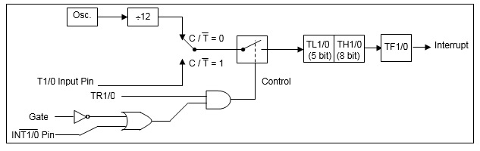
Counter/Timer Control Logic
Mode 0

Slide 18
Timer Modes of Operation
Timer Mode 0
  8 bit counter with a 32 bit prescalar
  Timer register is configured as a 13 bit register
    THX register as an 8 bit counter and TLX as a 5 bit counter
    the pulse input is divided by 32d in TL so that TH counts the original oscillator freq. / (12 x 32).

Slide 19
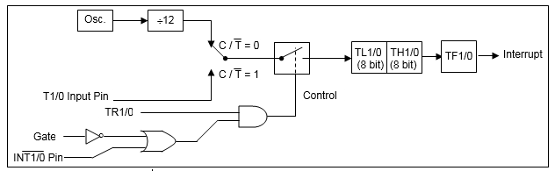
Counter/Timer Control Logic
MODE 1

Slide 20
Timer Modes of Operation
Timer Mode 1
Mode 1 is similar to mode 0 except that TLX is configured as an 8 bit counter.

Slide 21
To find the timer’s clock frequency and its period
Given any crystal frequency say (11.0592MHz),
Timer clock frequency :
(1/12) x 11.0592 MHz = 921.6 kHz
and its period :
T= 1/921.6 kHz =1.085 us

Slide 22
Steps to program timer’s mode 1 to generate a time delay
Load the TMOD value register indicating which time ( timer 0 or timer 1) is to be used and which timer mode (0 or 1) is selected.
Load register TL and TH with initial count values.
Start timer
Keep monitoring the timer flag (TF) with the “JNB TFx,target” instruction to see if it is raised. Get out of the loop when TF becomes high.

Slide 23
Stop the timer
Clear the TF flag for the next round
Go back to step 2 to load TH and TL again

Slide 24
Time Delay Calculations for XTAL=11.0592MHz
In hex
(FFFF – YYXX + 1) x 1.085 us
where YYXX are TH , TL initial values respectively. Notice these values are in hex.
b) In decimal
Convert YYXX values of the TH,TL register to decimal to get a NNNNN decimal number, then (65536 – NNNNN) x 1.085 us

Slide 25
Creating a square wave of 50% duty cycle (with equal portions high and low) on p1.5 bit. Timer 0 is used to generate the time delay.
MOV TMOD,#01H ;T0,M1
HERE:
MOV TL0,#0F2H ;
MOV TH0,#0FFH ;
CPL P1.5 ;TOGGLE P1.5
ACALL DELAY
SJMP HERE ; LOAD TH,TL AGAIN

Slide 26
; ----------DELAY USING TIMER 0---------
DELAY:
SETB TR0 ;START TIMER 0
AGAIN: JNB TF0,AGAIN ;
CLR TR0
CLR TF0
RET

Slide 27
Find the values to be loaded into the timer, desiring a particular time delay and given the crystal frequency (say 11.0592MHz).
N= desired time delay by 1.085 us
Perform 65536 – N,
Convert result of step 2 to hex, where yyxx is the initial hex value to be loaded into the timer’s registers.
Set TL=xx amd TH=yy.

Slide 28
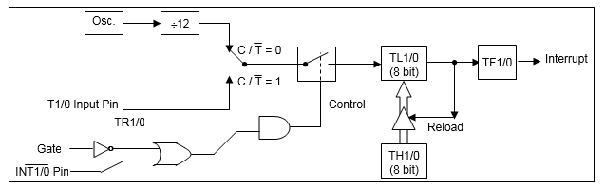
Counter/Timer Control Logic
Mode 2

Slide 29
Timer Modes of Operation
Timer mode 2 (Auto Reload)
TLX acts as an 8 bit counter.Every time TLX goes from FF to 00h ,THX gets the original value that was stored in TLX.

Slide 30
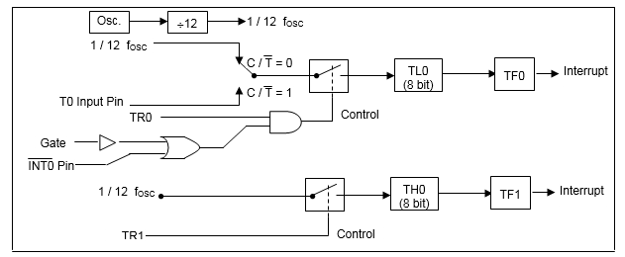
Counter/Timer Control Logic
Mode 3

Slide 31
Timer Modes of Operation
Timer Mode 3
Timer1 in mode 3 causes it to stop counting ;TR1 & TF1 are used by timer 0
Timer 0 in mode 3 becomes two completely separate 8 bit counters
Timer 1 can be used in modes 0 ,1 or 2 but it can not generate an interrupt

Slide 32
Programming the timer interrupt
Program to generate a square wave of 50Hz frequency on P1.2 using and interrupt for timer 0. Assume XTAL=11.0592MHz.
T=1/50 Hz=20ms,the period of square wave.
½ of it for the high and low portion of the pulse=10ms
10ms/1.085us=9216

Slide 33
d) And 6536 – 9216 = 56320d (DC00H)
e) TL=00 and TH=DC

